Slide 1
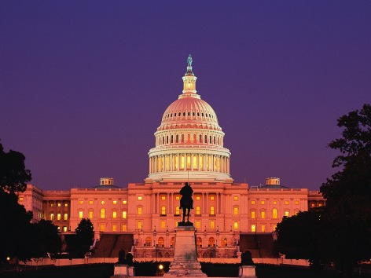
PRINCIPLES of GOVERNMENT

Slide 2
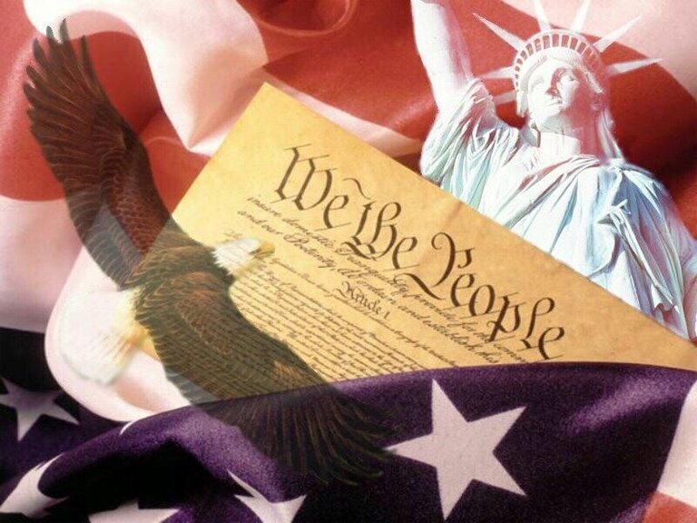
Popular Sovereignty
EQ: Who Gives the Government Its Power?
All government power belongs to the people
Popular | People
Sovereignty | Highest
Authority
First 3 words of the U.S. Constitution | “We the
People”

Slide 3
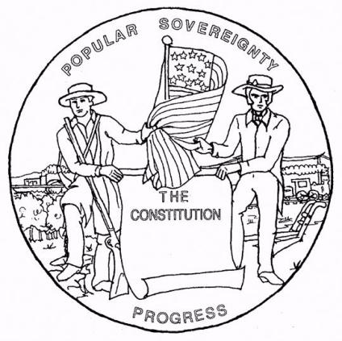
Popular Sovereignty
EXAMPLES…
The first and most important example: the Constitution itself
Voters must approve all amendments to the Constitution (U.S. and TX)
In the 1850s, voters in some western territories decided whether or not to allow slavery

Slide 4
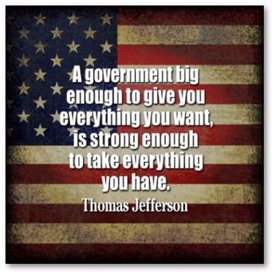
Limited Government
EQ: How Is Abuse of Power Prevented?
Government can do only what the people say it can do
U.S. Constitution:
Article 1|Section 9: Lists the
powers denied to Congress.
Article 1|Section 10: Forbids the states to take certain actions.

Slide 5
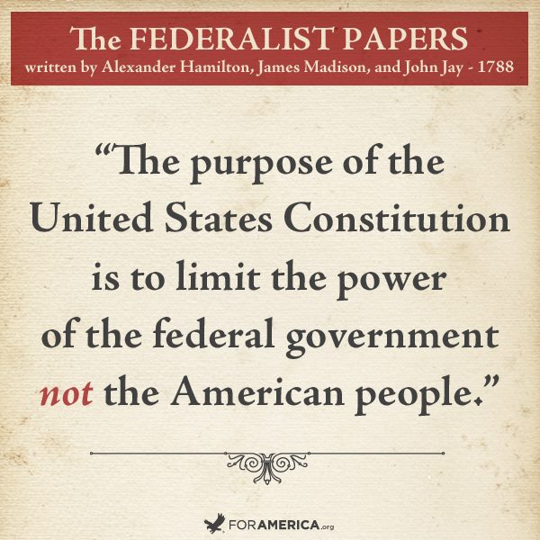
Limited Government
EXAMPLES…
The Bill of Rights limits the power of the federal government, not the American people
Checks and Balances
Separation of Powers

Slide 6
Separation of Powers
EQ: How Is Power Divided?
Power is divided among three separate branches of government
U.S. Constitution:
Article 1 | Article 2 | Article 3
----------------------------------------------------------------------------------------------
Detail how powers are split among the three branches… No one branch is given all the power.
2
3
1

Slide 7
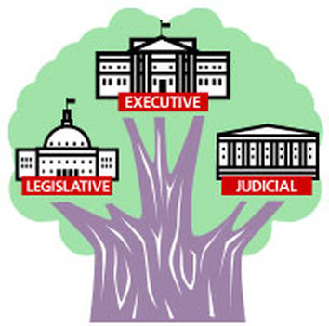
Separation of Powers
EXAMPLES…
The LEGISLATIVE Branch passes laws
The EXECUTIVE Branch enforces laws
The JUDICIAL Branch interprets laws

Slide 8
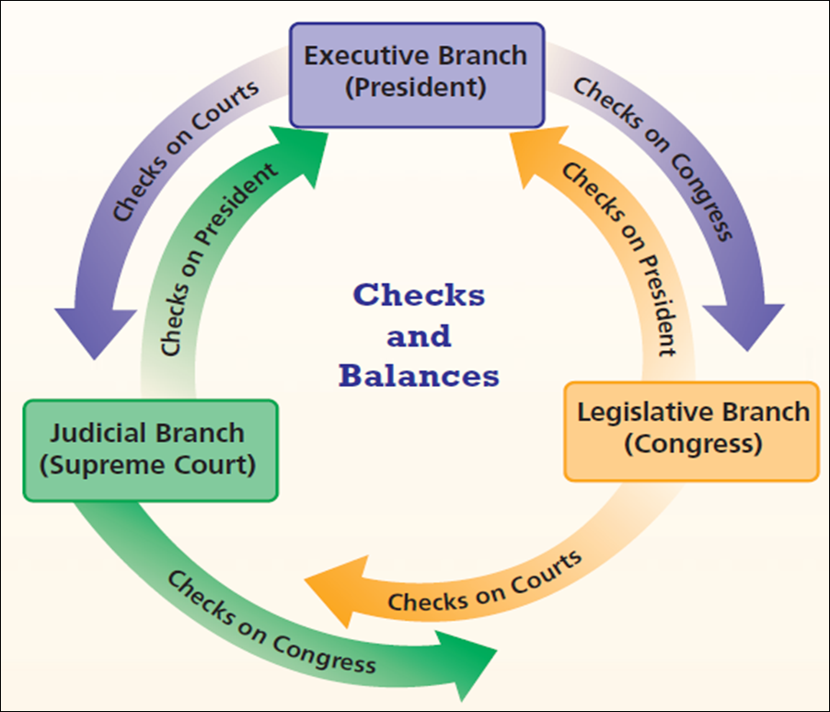
Checks and Balances
EQ: How Is Power
Evenly Distributed?
Each branch of government is able to check the other branches
Baron de Montesquieu,
an 18th-century French
thinker, wrote:
“Power should be
a check to power.”

Slide 9
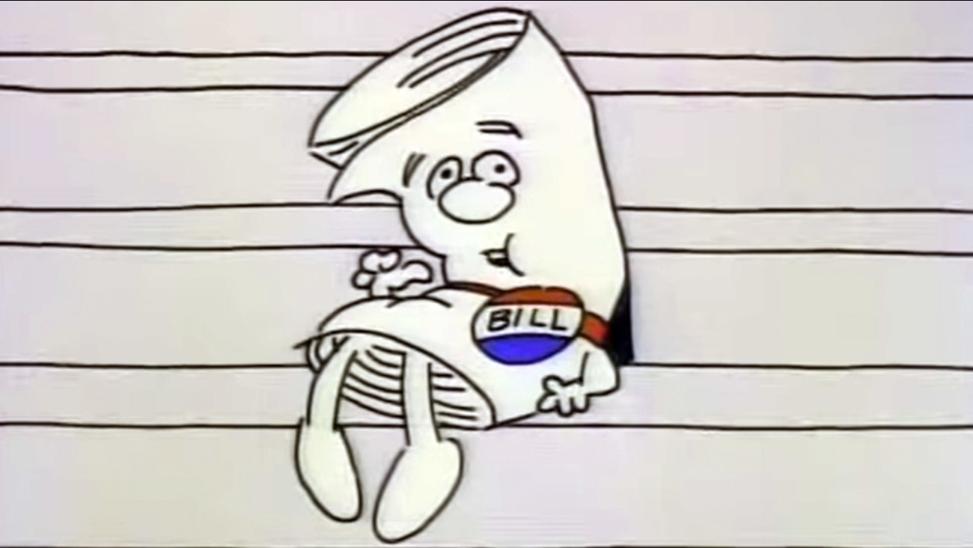
Checks and Balances
EXAMPLES…
Only Congress has the power to pass a Bill into Law.
The president can check this power by refusing to sign this Law (veto).
Supreme Court can declare that this Law violates the Constitution.

Slide 10
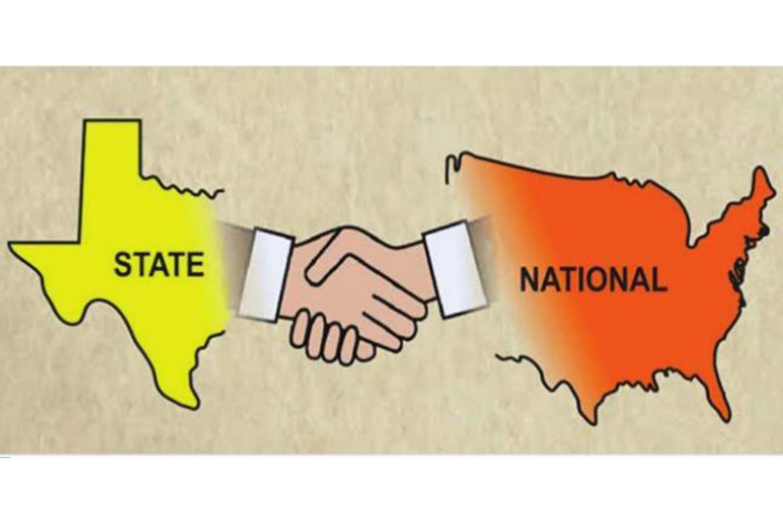
Federalism
EQ: How Is Power Shared?
Power is shared between the national government and the states
The Framers wanted the states and the national government to become partners in governing. To build cooperation, the Framers turned to federalism.

Slide 11
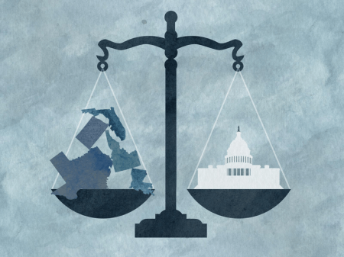
Federalism
EXAMPLES…
The Constitution assigns certain powers to the national government: Delegated Powers
Powers kept by the states: Reserved Powers
Powers shared by national and state governments: Concurrent Powers

Slide 12
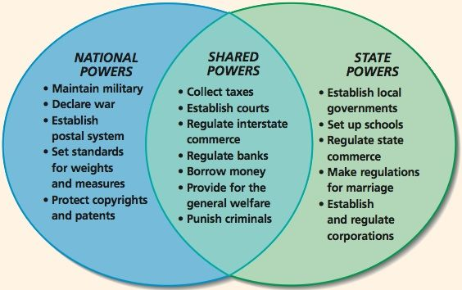
Federalism

Slide 13
Republicanism
EQ: How Are People’s Views Represented in Government?
Citizens elect representatives to carry out the will of the people
U.S. Constitution:
Article 4 | Section 4
----------------------------------------------------------------------------------------------
Calls for every state to
have a “republican form
of government”

Slide 14
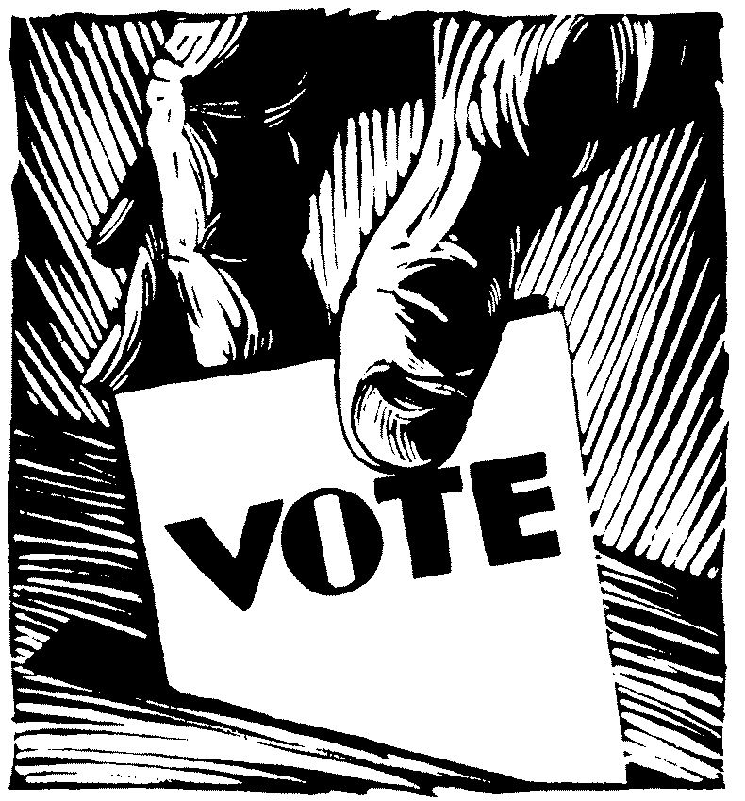
Republicanism
EXAMPLES…
The Framers feared public opinion might stand in the way of sound decision making
The power of the ballot prompts candidates to listen to people’s concerns
Citizens stay informed about politics and participate in the process

Slide 15
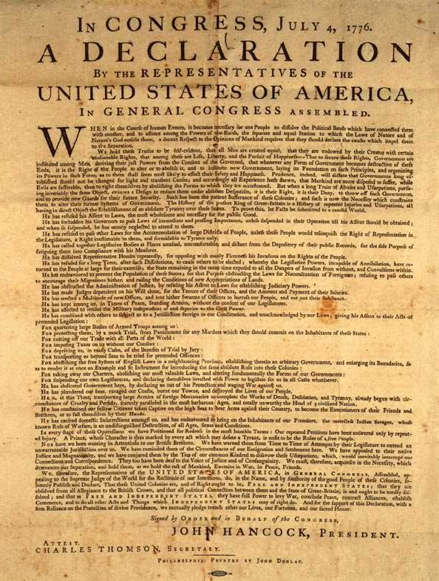
Individual Rights
EQ: How Are Personal Freedoms Protected?
Individual rights are protected by the Bill of Rights
The first ten amendments
to the Constitution shield
people from an overly powerful government

Slide 16
Individual Rights
EXAMPLES…
Government cannot control what people say or write or believe
The “right to life, liberty and the pursuit of happiness”
People have the right to meet peacefully and to ask the government to correct a problem

